Slide 1
Sorting Algorithm
Entity Resolution By Ahsan Khan
Notes:
This problem is called entity resolution in the world of data science

Slide 2
What is Entity Resolution (ER)?
Linking two entities together in different databases without the use of an unique ID
Notes:
An entity could be anything, you can be an entity and your data can be stored in multiple different clinics
-talk about hospital and clinic
So theres nothing to tell you that this entity and this entity are the same (unique number)
A person looking at the data will be able to determine similarity but with large amounts of data its impossible to do it manually

Slide 3
Coffee xyz
Cafe-rio → Coffee
Jack’s coffee
Plato’s Clothes
Clothing company xyz → Clothes
Uniqlo
Animal daycare
Cat grooming → Animals
Animal Shelter

Slide 4
Why this is important -
Businesses possess very large amounts of data in this era
Have a hard time grouping the same entities together for their accounting and other needs
Large corporations are only able to properly sort around 70% of their entities together and need a lot of manual input
Notes:
2nd point: no unique keys

Slide 5
Real world example -
JP Morgan can transact with Google under many different names such as
‘JP Morg Chase’
‘JP Morgan Investment Management’
‘JP Morgan INV MGMT’
‘JPM’
Notes:
So when google is for example doing their quarterly calculations - how would they aggregate all these transactions
Mind you theres going to be thousands of transactions with JPM so its not a google idea to do it manually

Slide 6
The Process -
Each entity and the entire database (corpus) is split into 3-character tokens
JP Morgan -> JPM PMo Mor org rga gan
Notes:
Remember this sorting is solely based on text data and no other labels like address etc

Slide 7
The Process - Example
Entity -
“JP Morgan Inv Mgmt”
Target in the database -
“JP Morgan Investment Management”
Notes:
So for example inv mgmt is what the human entered
And its target is investmanagnet and its what google has as their calc
Explain what target is
And thats what it needs to be sorted into

Slide 8
The Process -
“JP Morgan Inv Mgmt” is tokenized into -
JPM PMo Mor org rga gan anI nIn Inv nvM vMg Mgm
2) Then every single target in the database (corpus) is also tokenized into into 3 characters tokens
Notes:
So your entity is tokenized
And every single target is also tokenized
Literally every target - text is tokenized
Show csv of targets

Slide 9
The Process -
3) A number is assigned to every token which is determined by how many times a similar token appears in the entire database (corpus)
JPM PMo Mor org rga gan anI nIn Inv nvM vMg Mgm
...
0.34 0.12 0.23 0.33 0.11 0.26 0.44
...

Slide 10
The Process -
The numbers assigned to the tokens of “JP Morgan Inv Mgmt”
Will be similar and closest to:
The tokens and numbers of
“JP Morgan Investment Management”

Slide 11
The Process -
4) Finally, the algorithm determines the best matching target for an entity and sorts it respectively
Input: 2 tables, one for entities to be sorted and one for all targets
Output: 1 table containing all entities matched to respective target

Slide 12
Demo

Slide 13


Future
Handle Acronyms - Form acronym of an entity incase target contains acronym
Neural Network with Word2vec - Faster and more accurate sorting, Neural Network will be able to predict the next token after “JPM” is “Mor”
hnswlib - Faster and more accurate linking method using frequency numbers
Google Search Web Scraping Add labels to an entity based on very specific search results obtained from google - More general cases.
Notes:
So on top of assigning values, word2vec will predict next token
Hnswlib is a library which has fastest recall and accuracy score

Slide 14
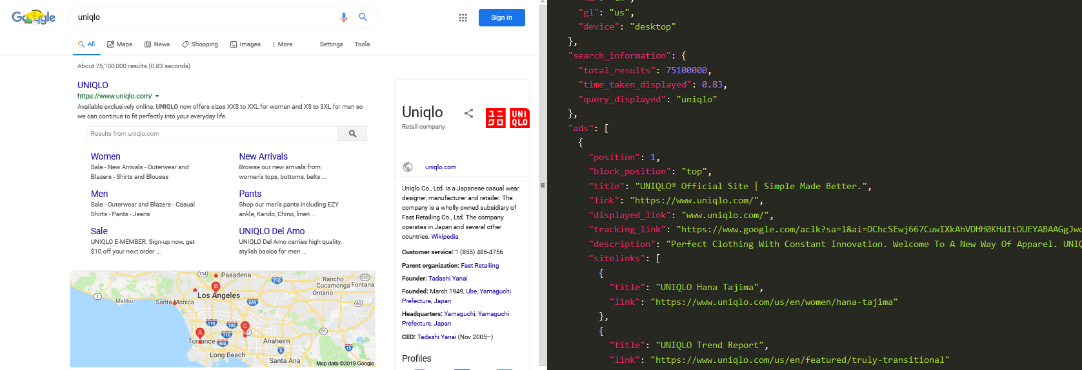
Google Search Webscrape Example

Slide 15
Technical Information
Preprocessing:
All punctuation and numbers removed. Text made lowercase.
All entities and entire corpus converted to vectors
Applied tf-idf and just tf to get vector representations
Indexing / Finding best match
Done by using Jaccard and Cosine similarity scores
Entity Resolution Algorithm for Featureless Text Data

